Slide 1
Leading a Horse to Water and Enticing Him to Drink
Terri Potts,
IIS Software Technical Director
Fred Pabon, DevOps Champion
October 2014
Notes:
Additional examples:
SLAMRAAM – Message Handler – adding messages late in cycle, automated testing.

Slide 2

Can you change the course?
Notes:
DevOps promises to bring relief to schedule and cost pressures, but people and organizations are creatures of habit. They’ll keep following the same path for decades unless something happens to change their course. Have you ever felt that the journey to DevOps feels like changing the course of the Colorado River? I’d like to share some of my experiences on our DevOps transformation journey.
Horseshoe bend picture from Pixabay.
License: CC0 Public Domain
Free for commercial use / No attribution required
http://pixabay.com/en/horseshoe-bend-page-arizona-4041/

Slide 3

Our Organization
Large Aerospace & Defense company
IIS = Intelligence, Information & Services
Development spread across > 10 US sites
Customer is risk averse
Notes:
IIS is one of four Raytheon businesses. We have roughly 100 government customer systems that we’re developing or maintaining. Some very large Satellite Ground System programs with software teams of over 100 people and development and “operations” teams of over 300 people. Among other things, ground station operators must regularly plan and send commands to the satellite to make small adjustments to keep it in the appropriate orbit. Or give it commands when it’s orbit has decayed so it reenters the atmosphere over the ocean rather than over your house!
We also have small programs such as situational awareness Google-glass-like devices for Army troops and pilots. A small device fitted to their helmet flips down over their left eye and earphones in their helmet combine to show them where their squad mates are (blue force tracking).
We have a total of 1400 Software Developers and over 3000 engineers of all disciplines
Customer is process focused. Usually we define our processes, but customer almost always has approval authority over our processes – can refuse to allow the use of Agile, automated test, etc.

Slide 4
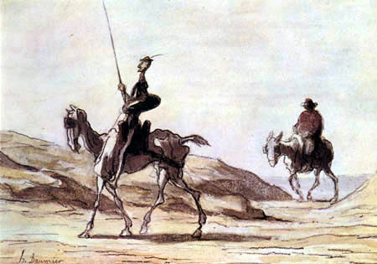
My evangelism story
11 years Air Force
16 years at Raytheon
Software Product Lines
Code Generation
Automated Test
Architect
Agile
10/16/2014
4
Notes:
Before I joined Raytheon, I was in the Air Force for 11 years working all phases of system acquisition (software development, program office, operational test and evaluation). When I joined Raytheon sixteen years ago, I was young, optimistic and passionate about saving the customer money and delivering a high quality product, unlike those other aerospace & defense contractors I had worked with when I was active duty. ;-) In 2000, I ran across a tool and process for generating high quality source code from UML models. We had fantastic results – double the standard productivity with half the defects. Wow! I thought I’d discovered gold and there would be a rush for the whole organization to do the same thing. Guess what…no rush. In fact, no interest and even skepticism.
I ran into major resistance:
Managers only saw the risk of changing our process
People said I lied about the metrics!
Others said I must own stock in the tool company
Some people told me that if we adopted this, they, as software developers wouldn’t be needed anymore, so they weren’t interested
Being very stubborn and convinced this was the right thing to do, I kept fighting for adoption. Friends started calling me Dona Quixote!
It took me 12 years to give up trying to make whole sale change in the organization by ‘selling’ the technology.
Don Quixote illustration from the 18th-century artist Honoré Daumier
http://www.vanderbilt.edu/rpw_center/newsletter/2012-spring/ls12d.php

Slide 5


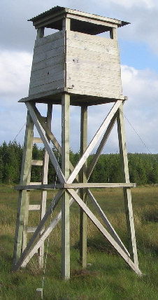
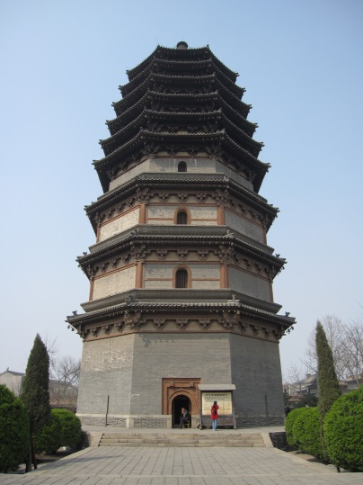
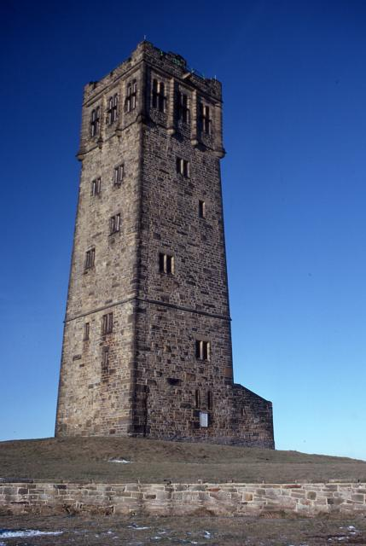
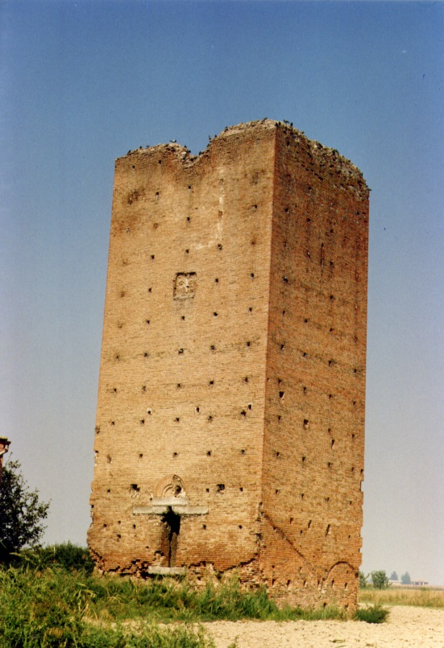
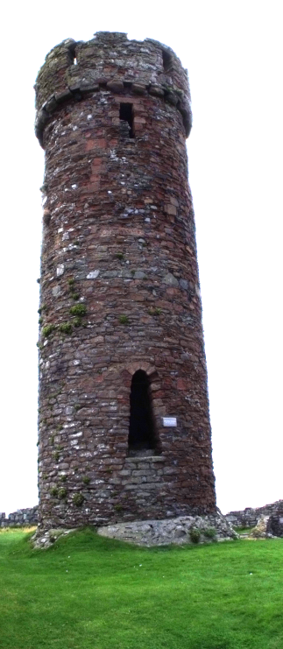
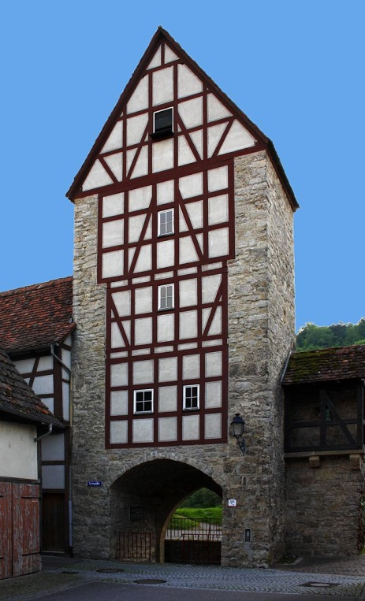
Typical program
10/16/2014
5
Notes:
Simplified view of a program:
A typical program in Aerospace and Defense starts with the operators or users of a system deciding they need a new or upgraded system. They speak to an acquisition agency (often folks that have never used a system like this). That agency becomes our customer. The customer writes down a set of very high level requirements and key performance parameters (KPPs). The customer gives the requirements and KPPs to our Systems Engineering organization. Sometimes the customer and System Engineering don’t really have any technical interaction for months after that.
The defense contractor systems engineers write more detailed requirements and possibly draw some diagrams in models. If we’re lucky, the SE team invites the software, hardware, infrastructure and integration and test teams to in-person reviews of the work they’re doing. In other cases, the SE team throws the requirements and architecture over a tall and thick wall to the software, hardware, infrastructure and integration and test teams with no discussions.
From there, Infrastructure purchases all the servers and racks needed to host the application, provisions it with some of the COTS software.
In parallel, the Software team starts work. Each developer has to find, install and configure all the necessary tools, COTS and FOSS they’ll need. Sometimes it takes a developer months to get their development environment right. The team designs and codes the application based on their interpretation of the requirements. Then they manually run unit tests and software component thread tests after a 4-9 month development cycle. Plenty of process layered in here with design peer reviews, code peer reviews, etc. Including coding standards, hardening against cyber vulnerabilities, protection against safety concerns etc.
When the software is done, they throw the software over their wall to the Configuration Management team. The CM team is creating builds, deploying builds and patches to systems, and managing the configuration the same way they did 30 years ago – completely manually. They’re overloaded now supporting systems with millions of lines of code, multiple build components taking 8+ hours, hundred of thousands of configuration parameters, and deploying to 4 or 5 environments.
While all this is happening, the integration and test team(s) is busy writing integration procedures and sell-off tests based on the requirements. These are generally manual procedures. When CM deploys the executables (4-9 months of work) to the environment, sometimes from 10 or 12 separate teams, the integration team gets started. It can take weeks just to get the system to start up appropriately. Once it’s actually running on the hardware, they start walking through their manual procedures, red-lining them to get them to match with the system that has been developed, creating defects where capability is missing or where the software team didn’t interpret the requirements the same way the test team did.
After months or years of integration and test, the build is handed back to CM, who delivers it to the Operations Support team, who manually installs it in the customer environment and runs another set of manual tests to make sure everything is working in the Ops environment as expected. This can take another couple of weeks or months (working long hours).
Then the end user gets their hands on it. It’s likely the first time they’ve seen it, it’s 2 or more years after the process started and they’re often unhappy with the product. On one Air Traffic Control program that Raytheon had, the development team did a HMI design using all the latest techniques and methods. They spent years designing and implementing the HMI. When they finally got it in front of the controllers, it was completely rejected because we didn’t understand all their usability scenarios. But many man years went down the tubes for lack of interacting early and frequently with the end users.
Despite both Defense Contractors and the Customer being unhappy with the end results, the customer is still generally requiring this basic process in their contracts, afraid that change is risky. In addition, our engineering organization is organized along these lines. Converting these large programs and the larger engineering organizations is not a realistic expectation at this time. So, let’s talk about how we’re evolving the way we do business.
Tomomarusan - http://commons.wikimedia.org/wiki/File:Kobe_Crystal_tower.JPG
Patrick Makhoul - http://commons.wikimedia.org/wiki/File:Air_traffic_control_Yerevan.jpg
Zeus1234 - http://commons.wikimedia.org/wiki/File:Zhengding_Lingxiao_Pagoda_3.jpg
Richard Harvey - http://commons.wikimedia.org/wiki/File:Victoria_Tower_Castle_Hill(RLH).jpg
Malost - http://commons.wikimedia.org/wiki/File:IOM_Round_Tower_Peel_Castle_by_Malost.JPG
Franco Ardizzoni - http://commons.wikimedia.org/wiki/File:Galliera_-_Torre_medievale_-_sec.XII-XIII.jpg
Robert Bone - http://commons.wikimedia.org/wiki/File:Observation_Tower,_Strathy_Forest_-_geograph.org.uk_-_102180.jpg
Rudolf Stricker - http://commons.wikimedia.org/wiki/Category:Timber_framed_towers#mediaviewer/File:Niedernhall_Salztor_20100615.jpg

Slide 6
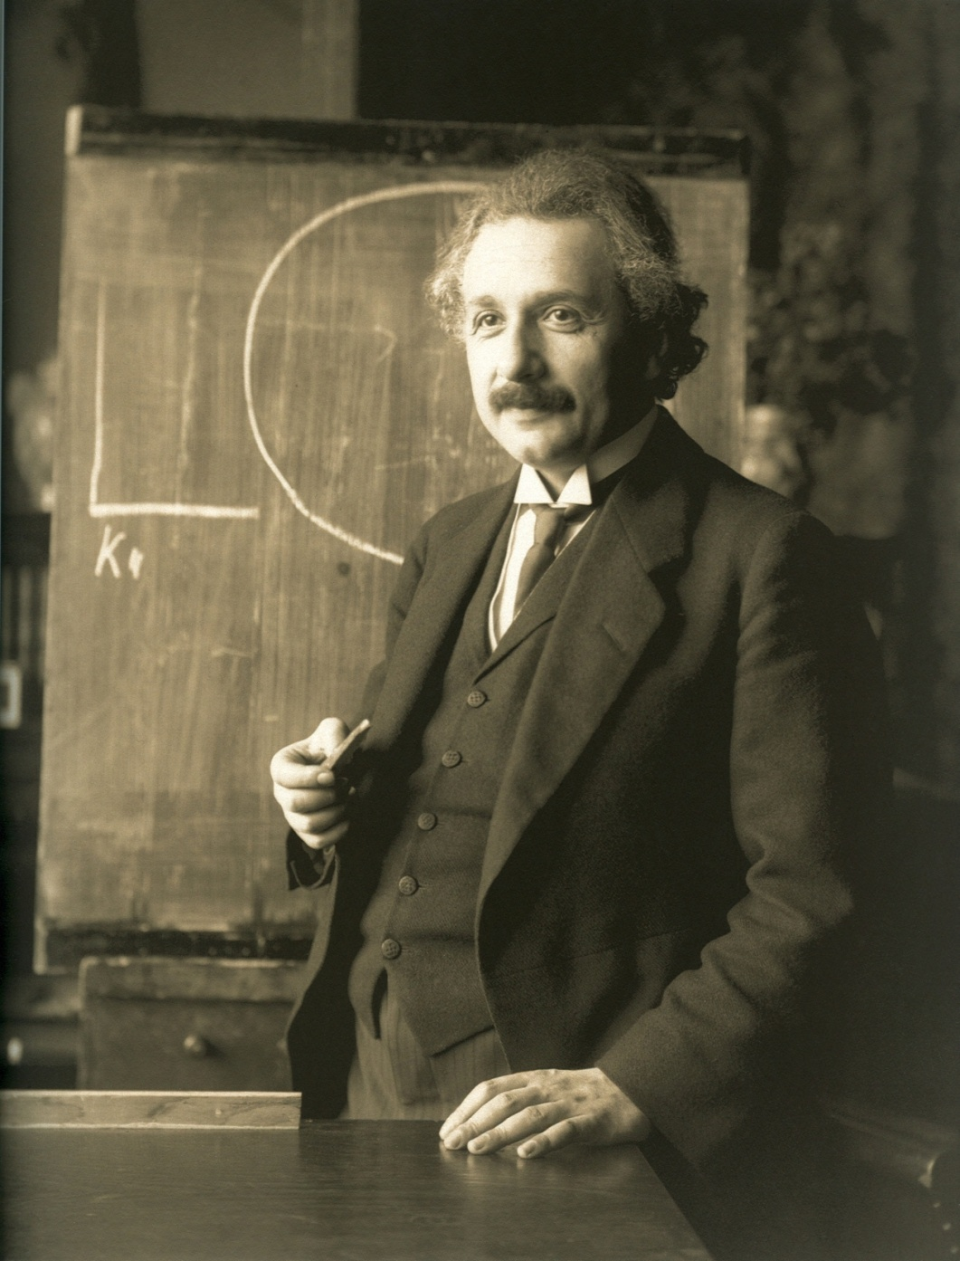
Created Subject Matter Experts
Notes:
Aspen
4 year joint Raytheon-Microsoft research effort to:
Explore the use of Microsoft Factories for enabling reuse of legacy systems
Create an source of internal experts on toolkits, agile, CI, automated test, etc
Microsoft built tooling within Visual Studio to enable the creating of toolkits
Microsoft hoped to sell more Visual Studio licenses to Raytheon.
Raytheon hoped to make reuse of legacy code easier, faster, more repeatable.
Microsoft Factories / Toolkits
Agile/Scrum
Lean software development
Cross-functional teams
Model-Driven Development
Test Driven Development
Populated with engineers from various geographic regions
Application Lifecycle Management tools (Visual Studio / TFS)
Albert Einstein 1921 by F Schmutzer" by Ferdinand Schmutzer - http://web.archive.org/web/20071026151415/http://www.anzenbergergallery.com/en/article/134.html. Licensed under Public domain via Wikimedia Commons - http://commons.wikimedia.org/wiki/File:Albert_Einstein_1921_by_F_Schmutzer.jpg#mediaviewer/File:Albert_Einstein_1921_by_F_Schmutzer.jpg

Slide 7

Spread the expertise
Notes:
Once people were experts, we sent many of the team members back to their home organization to spread the knowledge to one or more programs in their organization. The senior leader types went on to make large organizational changes, starting with one program at a time. An example was a very large Navy program with a funding shortfall. One of the Aspen leaders went to the program that had hundreds of software engineers. He worked with the program management to educate the customer about agile, how to estimate the work, and changed all the processes followed by the software team.
Fred went back to his organization and brought all of the techniques to his organization. They rely on him to come up with suggestions on how to help individual programs based on the programs needs. He has successfully introduced Agile, toolkits, automated test and continuous integration, and cross-functional teams. In Indy, they’ve been so successful converting one team to agile, automated test and CI that the customer now works with them to establish the number of story points that will be performed on the next contract and to prioritized stories for each sprint.
We also used the Aspen Center as a place to showcase the possibilities. A system engineer from a program in Omaha brought his customer to the Aspen Center, where we walked him through the concepts of Agile, Scrum, CI, automated test, cross function teams, etc. The program provides a web-enabled system to the Air Force weather forecasters that provides weather in support of flight operations and ground safety. The program also supplies 24/7 help desk support to over 150 systems across the world. On arriving at the Aspen Center, the customer was angry and was threatening to cancel the program for lack of performance and unacceptable products being delivered. He believed that Raytheon didn’t know how to build software systems. By the end of his 3 hour visit to the Aspen Center, he was convinced that we did have good ideas on how to execute a program. After further discussions, he was willing to let the System Engineer institute process changes on the program, applying scrum, CI and automated test. 1 year later, the customer is thrilled with the performance of the team and the quality of the end product. The team was so efficient that it delivered all the required capability for significantly less money than was planned in the contract and ahead of schedule. The customer was able to use the leftover funding to build in additional capability.
Dandelion picture from Pixabay.
License: CC0 Public Domain
Free for commercial use / No attribution required
http://pixabay.com/en/dandelion-close-seeds-333643/

Slide 8
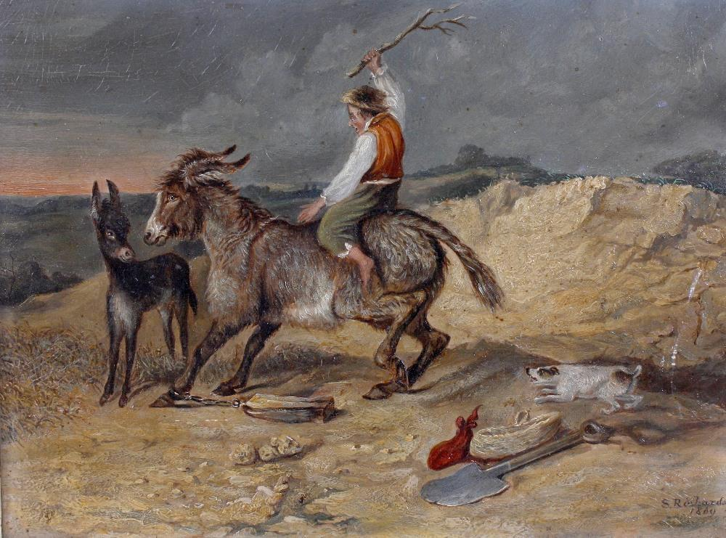
Enticing the horse to drink…
Before test automation:
1 Million Lines of Code integration effort
Manual integration achieved 2-3 procedures per month
2-3 days to “good enough”
After test automation:
Run 26 procedures daily
27th procedure over the weekend
2-3 hours to “good enough”
Support 3 builds simultaneously
Notes:
I found that when I ran into teams that found every excuse why they couldn’t implement a technique, like CI or automated test, I brought someone to the team that could get the job started for them. An example is on one large satellite ground station program, I brought in a few of the individual contributors from Aspen. They taught program engineers how to create toolkits, and worked with them on the first three sprints. By that time, the program engineers felt they could move forward mainly on their own.
On the same team, we used the same technique to automate segment integration. This integration was building up about 1 million lines of code. The segment integration team was interested in automated test, but didn’t really know how to get started. Again, we had some Aspen experts come in. We paid them to create one end-to-end automated test. Once they had it automated, they hooked it up to Jenkins and showed the team what to do. From there, the integration team went on to automate another 26 procedures. Before automated test, they were able to support check-out and integration on one build at a time. They ran 2-3 procedures per month. It took them at least 2-3 days to call the build “good enough” to enter integration. Post automation, they can tell the software team whether the build is good enough within 2-3 hours. They run 26 procedures every night and the 27th runs on the weekend. They’re able to support 3 builds at a time. It’s a tremendous success story.
S. Richards - A man riding a stubborn mule (1869) is in the Public Domain

Slide 9
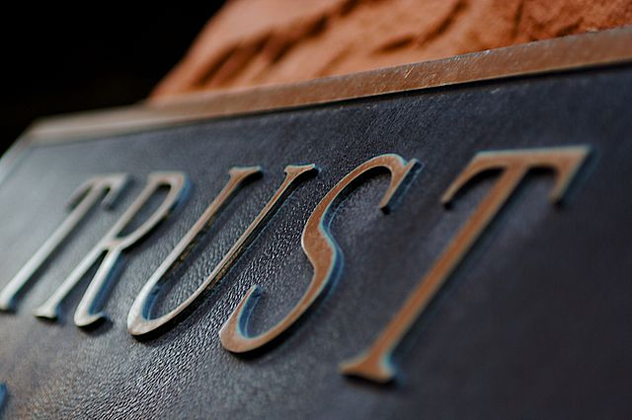
Gained trust
By Terry Johnston from Grand Rapids, USA (Trust) [CC-BY-2.0 (http://creativecommons.org/licenses/by/2.0)], via Wikimedia Commons
Notes:
We found that we had to gain trust with the teams before we could grow the DevOps adoption. For example, on one program in Indianapolis, when we first automated tests, the customer insisted that they still had to witness running the sell-off tests. Fortunately, we were using Ranorex, and could use the 8x speed visualization mechanism. Once the customer saw the value, repeatability, consistency of the tests, they began to trust that the automated tests could deliver equal certainty. Now we have shifted to increased focus on building the right automated tests and less emphasis on watching the tests run.
In the example of the toolkits, bringing the Aspen team to the program built trust between the SMEs and the developers. After the Aspen SMEs went back home, the Aspen team felt comfortable calling back to the SMEs when they ran into challenges they hadn’t previously faced.
On a large weather satellite ground station, a team had a particular schedule and budget challenge. They wanted to start using agile with a cross-functional team. The customer was concerned about the process changes, so the team agreed to pilot the process and team changes on a single component. They began to use scrum with 3 week sprints. They invited the Customer, Ops Engineers and End Users to sprint demos every three weeks. End users gave feedback on the functions that were demonstrated. After 4 months of development, the team was able to deliver completely new capability to the End Users, who were truly delighted with the product for the first time on the program. The customer was so impressed with the quality, agility and cost that they approved to move other component teams to the same process.

Slide 10
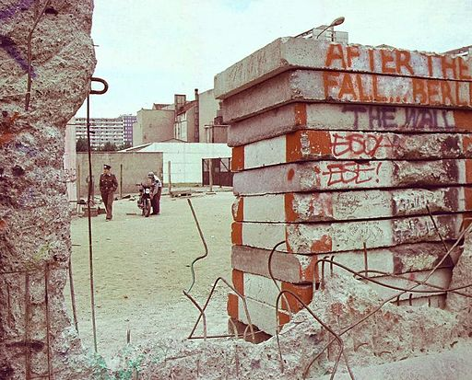
Broke down walls one-by-one
"DDR wall peekaboo" by Jurek Durczak from Poland - DDR. Licensed under Creative Commons Attribution 2.0 via Wikimedia Commons - http://commons.wikimedia.org/wiki/File:DDR_wall_peekaboo.jpg#mediaviewer/File:DDR_wall_peekaboo.jpg
Notes:
On a large satellite ground station program, we had to take the walls down one at a time. The software team started by automating the builds and handing them to the Configuration Management team. As the CM team saw the value, they were able to set up a shared Jenkins server to continuously build the software. Then they added the automated segment integration test to Jenkins. When the CM team saw that they could trust the builds because the test passed, they were able to automate the deployment of the build to the segment integration team.
In the same way we’ve started scrum teams with just software developers, but one at a time, brought in the system engineers, infrastructure engineers, integrators, customers and end users. Yes, it would be great to convert the organization over night, but that’s really hard to do.
So lets say there is a bug in software what happens?
Systems: Software injected a bug
Software: Systems missed an important requirement
Systems: That should have been a derived requirement
Software: We have to fix all of the problems
It is a very us vs. them mentality. Blame focused rather than team focused.
Again with cross functional teams we saw shifts in team dynamics. When systems & software are sitting right next to each other people start to better understand the other side’s perspective
Software better understands challenge of defining ALL requirements
Systems less likely to blame
Start seeing both groups working together, creates better requirements early
Focus has changed from avoiding blame to working as a team to find opportunities for improvement

Slide 11
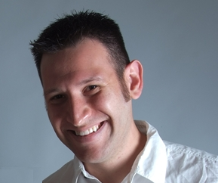

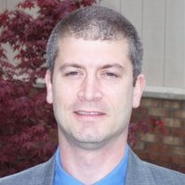
Change Agents
Notes:
Feed and care for people in your organization that are passionate about DevOps. Fred was able to go back to his organization and make significant changes because his boss supported him, encouraged him, and communicated that to the organization. Fred works on organization-wide efforts, he educates programs about the techniques and methods, and he does work on programs to get them started in the right direction.
Beware of letting him be consumed by any one program.
He’s more valuable as a resource to the whole organization than he is to any one program.
This is a leadership issue. Keep the leaders informed of your Change Agents’ value by reporting on the results they’re creating on individual programs.
When you see the value, ensure you have enough Fred’s

Slide 12

Show results to get more adoption
Notes:
Don’t be put off because managers or customers won’t make big changes based on your enthusiasm alone.
Start by piloting your ideas on a small team.
Show the Return on Investment or the savings from changing process/methods/techniques.
Pitch it to program managers as an opportunity
When others see your success, they’ll want to get a piece of it. Managers will be happy with the results, and will encourage more adoption.
This picture was created by an FBI employee and therefore is in the Public Domain.

Slide 13
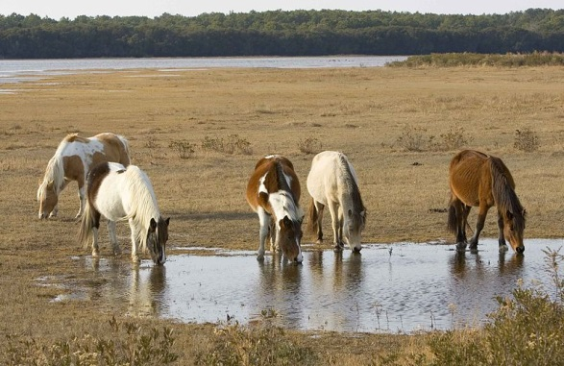
Key ways to entice your horses
Customer
Systems
Infrastructure
Integration
Software
Notes:
To recap things that are working at Raytheon:
Train a group of Subject Matter Experts
Spread the expertise around
When a team doesn’t feel they have time to learn new techniques, bring a SME to the team
Gain trust – work closely with your customer, and have your SMEs work closely with the programs
Break down walls one at a time
Find and grow change agents
Show results to get more adoption
http://commons.wikimedia.org/wiki/File:Wild_pony_or_assateague_pony_equus_caballus.jpg
This work has been released into the public domain by its author, Hillebrand Steve, U.S. Fish and Wildlife Service. This applies worldwide. In some countries this may not be legally possible; if so: Hillebrand Steve, U.S. Fish and Wildlife Service grants anyone the right to use this work for any purpose, without any conditions, unless such conditions are required by law.

Slide 14

Here’s what I’d like help on
How can I convert large legacy programs (1 Million+ Lines of Code) to automated test with minimal schedule and budget??
Picture by: VTda.info - vtda.info/node/86 License: Creativecommons.or/licenses/by/4.0/legalcode,

